Slide 1
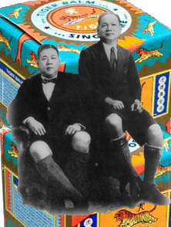
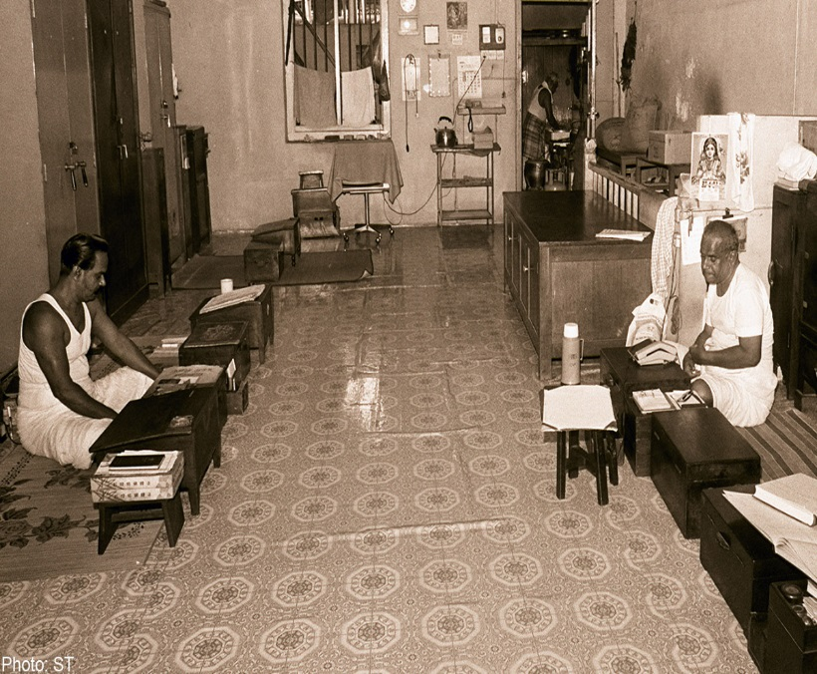
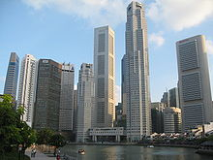
NATIONAL UNIVERSITY OF SINGAPORE
DEPARTMENT OF HISTORY
Singapore’s Business History
Lecture I (Part II)
A/P Medha Kudaisya

Slide 2
Session Outline
What is business history ?
Development of ‘business history’ as a discipline
Why study Singapore’s Business History ?
Introduction to the tools of the craft of Business History
Case Study: Eu Yan Sang

Slide 3
What is business history ?
Business Past
Individual firms: Micro and Macro developments
Markets
Entrepreneurs and Managers
Cultures
State
Forms of Enterprise
Nature and origins of innovation
Inner workings of trade and business

Slide 4
DEVELOPMENT OF ‘BUSINESS
HISTORY’ AS A DISCIPLINE
Economic History
Business History in Europe:
  1825: Iron Works in Germany (first company history) Lauchhammer Iron Works in Saxony
  1900 Siemmens Brothers history (University of Rostock)
Business History in the USA:
Political environment of late 19th century America
  Ida Tarbell, The History of the Standard Oil Company (1904)
  Myer, History of the Great American Fortunes (1909)

Slide 5
Developments within BH
Emergence of the term ‘Business history’ : 1920s
N S B Gras, Professor of Business History at HBS
Impact of the Great Economic Depression 1930s
  Political backlash against big business
  Polemical writings
    ‘Robber Barons’

Slide 6
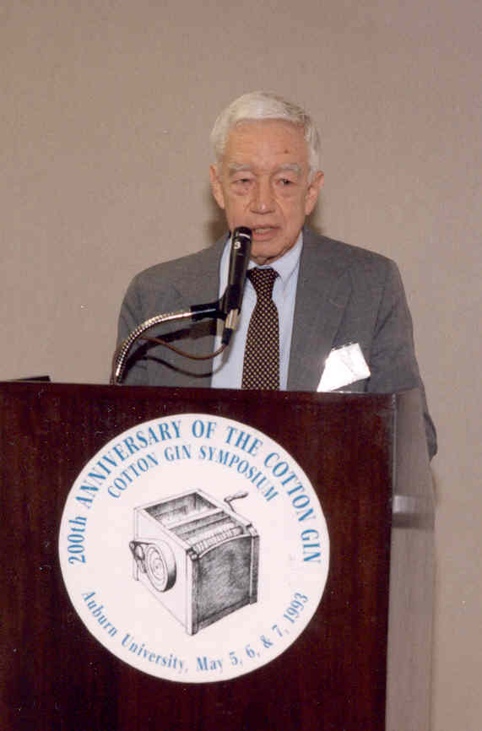
Modern era of ‘business history’ (1950s)
Reasons for the rise of ‘business history’
  Political environment of the post-war years
Role of Alfred Chandler
New writings
  Institutional history
  Studies of groups of individuals
  Government-business relations
  Biographies
  Study of the firm

Slide 7
Why study Singapore’s Business History ? (I)
The Economic Story, post 1965: Huge Success (‘Miracle’) ; ‘most laudable’ in East Asia and ‘most enigmatic’ (G. Huff)
Between 1965 and 1997: per capita income growth averaged 6.6% annually, higher than any other country
Consistently high Per capita income; full employment since 1973, relatively equal income distribution and virtual elimination of absolute poverty

Slide 8
Singapore’ Macroeconomic Indicators, 1960-1997 (per cent and annual averages)
 | 1960-66 | 1967-73 | 1974-79 | 1980-89 | 1990-97
Annual Real GDP growth rate | 5.7. | 13.1 | 7.5 | 6.3 | 8.2
Annual inflation rate | 1.1 | 4.3 | 2.5 | 1.9 | 3.0
Share in GDP
Manufacturing | 18.0 | 24.7 | 27.9 | 26.9 | 27.3
Financial and Business Services | 15.3 | 16.9 | 19.2 | 24.3 | 27.0
Other | 66 | 58.4 | 52.9 | 48.8 | 45.7
Share in Employment
Manufacturing | 14.2 | 22.0 | 27.6 | 28.0 | 25.9
Financial and Business Services | 4.6 | 4.0 | 6.4 | 8.5 | 12.4
Other | 81.2 | 74.0 | 66.0 | 63.5 | 61.7

Slide 9
Why study Singapore’s Business History ? (II)
Sustained Economic Growth
Strong Export Orientation
High Savings and investment
Low Inflation
Political stability & Economic Development

Slide 10
Why study Singapore’s Business History ? (III)
Fundamental Structural Transformation
  Expansion of Manufacturing
    Production of electronic goods
    1980s rapid emergence of financial and business services (as high a proportion of GDP as Manufacturing)
    Development of Singapore as an international financial center (fourth largest foreign exchange market; center for trade in Asian dollars)
Concerns
  Need for creativity and technical change which drive long-term economic growth

Slide 11
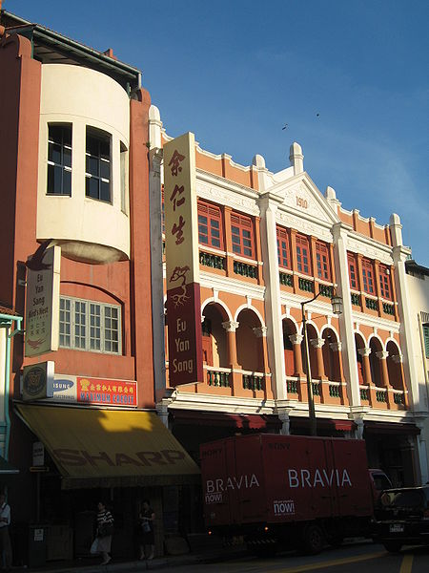
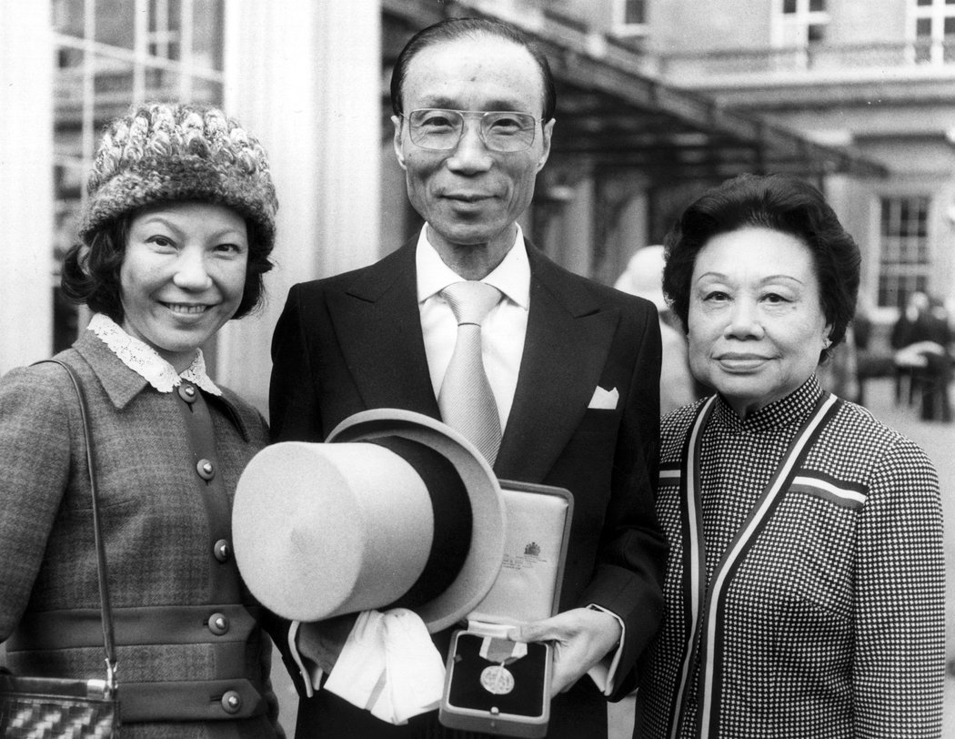
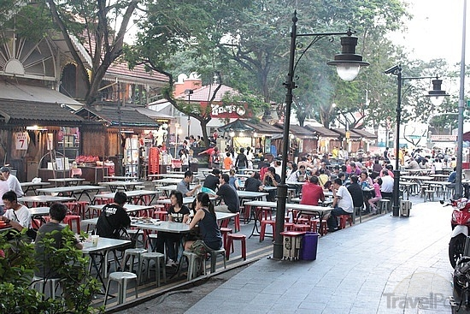
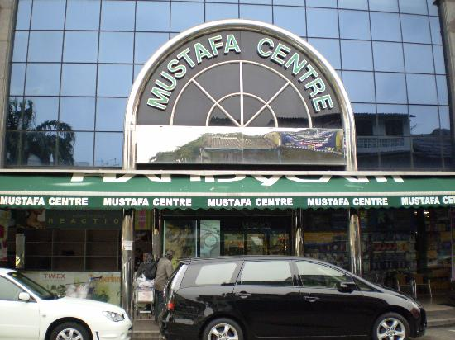
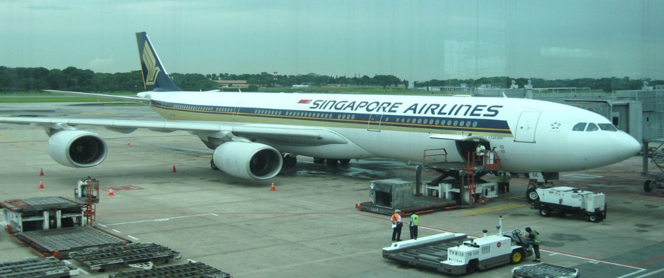
Some actors in Singapore’s Business History ?
Run Run Shaw with his wife and daughter

Slide 12
The tools of the Business Historian
Sources for the study of Business in Singapore (I)
Government Records
  Colonial Records
  Post colonial records
Commercial Directories
Commercial and Industrial Year Books

Slide 13
Sources for the study of Singapore’s Business Hisory (II)
Papers of Business Associations
    Clan associations: Hokkien Huay Kuan
    Surname associations
    Native place associations
    Caste Associations
    Chambers of Commerce
Records of occupational and trade guilds
  Singapore Tea Importers and Exporters Association (from 1928)
  Ngee Ann Kongsi (from 1933)
  Singapore Chinese Chamber of Commerce (from 1906)
  Nanyang Khek Community Guild (from 1927)
  Singapore Indian Chamber of Commerce (1924 Indian Merchants Association)

Slide 14
Sources for the study of Singapore’s Business History (III)
Private Papers
Newspaper sources
Commemorative works etc
Biographies & family histories
Oral history sources

Slide 15
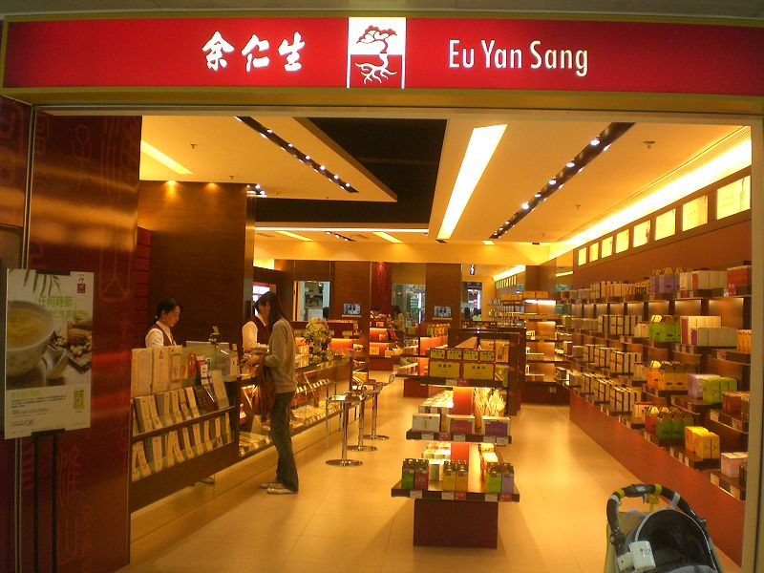
Case Study: Eu Yan Sang Medical Shop, 1876-
Sources:
  Archival sources (government records)
  Account books of EYS (100 volumes from 1914-1980)
  Family correspondence and wills (1876-1980)
  Shareholding records and company registration papers
Account books of EYS (100 volumes)
  “remittance,” “medicine,” “grocery stores” and “tablet manufacturing”

Slide 16
Summing up
Significance of the study of business in Singapore’s history
Importance of studying business history by placing the business firm/ enterprise/ trading community/ business persons in historical context

Slide 17
Readings
Vinnie Lauria, “What Makes An Asian Tiger? Singapore’s Unlikely Economic Success Lies in its History” Forbes Magazine, 2/10.2014
W.G. Huff, The Economic Growth of Singapore: Trade and Development in the Twentieth Century. Chapter 1. [E-book]

